Slide 1
An Introduction into TensorFlow
By: Jared Ostmeyer
Laboratory of Dr. Lindsay Cowell, UTSW
https://github.com/jostmey/NakedTensor

Slide 2
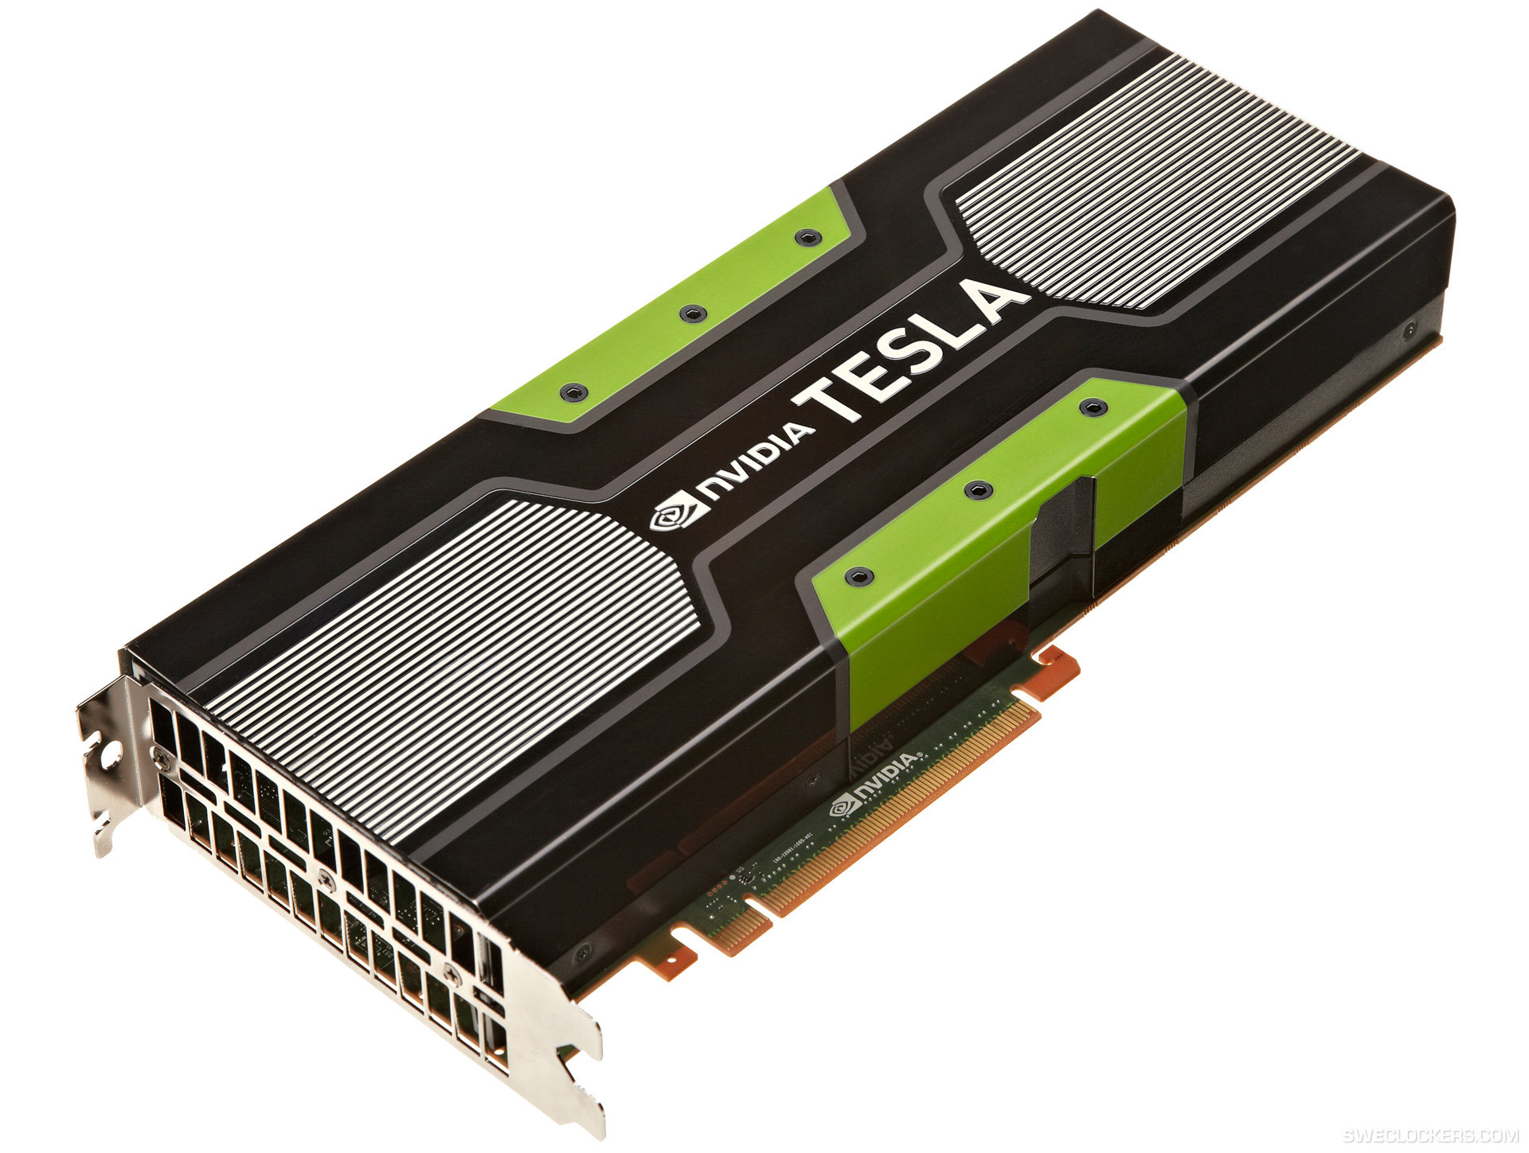

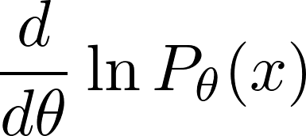
What is TensorFlow ?

Slide 3


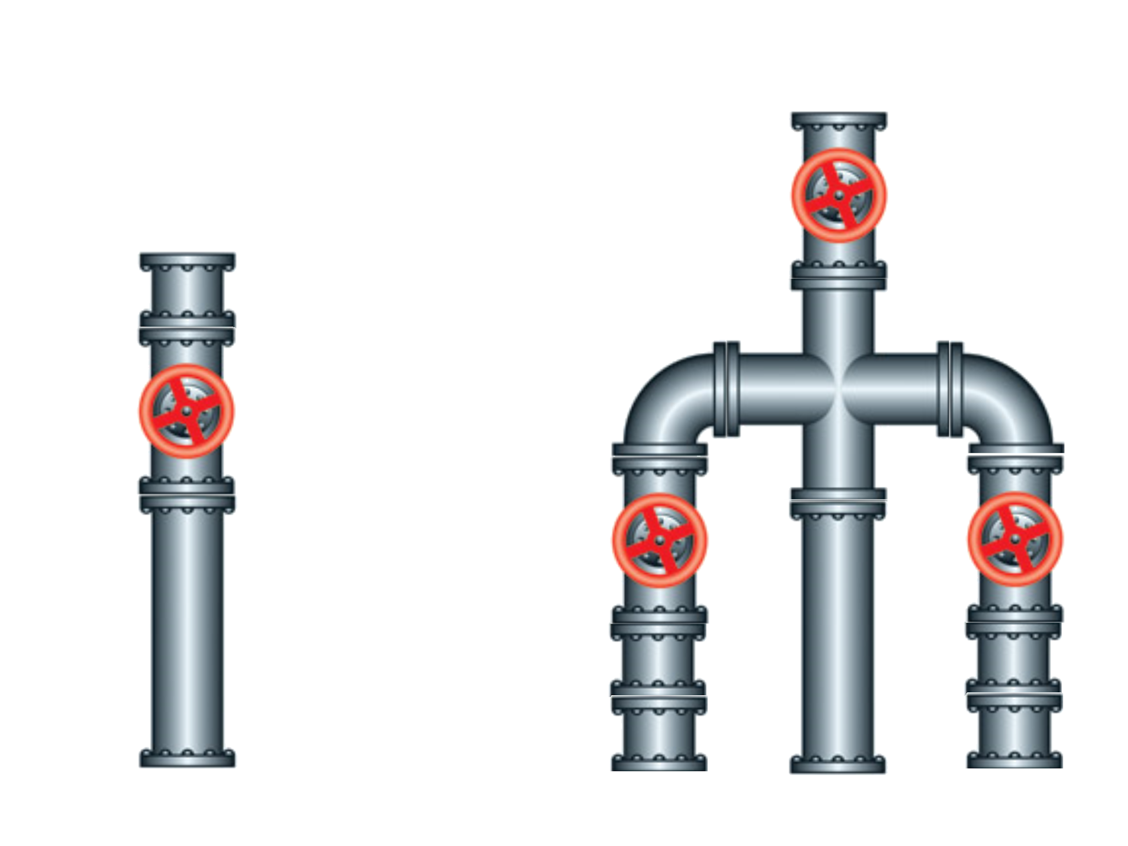

Slide 4
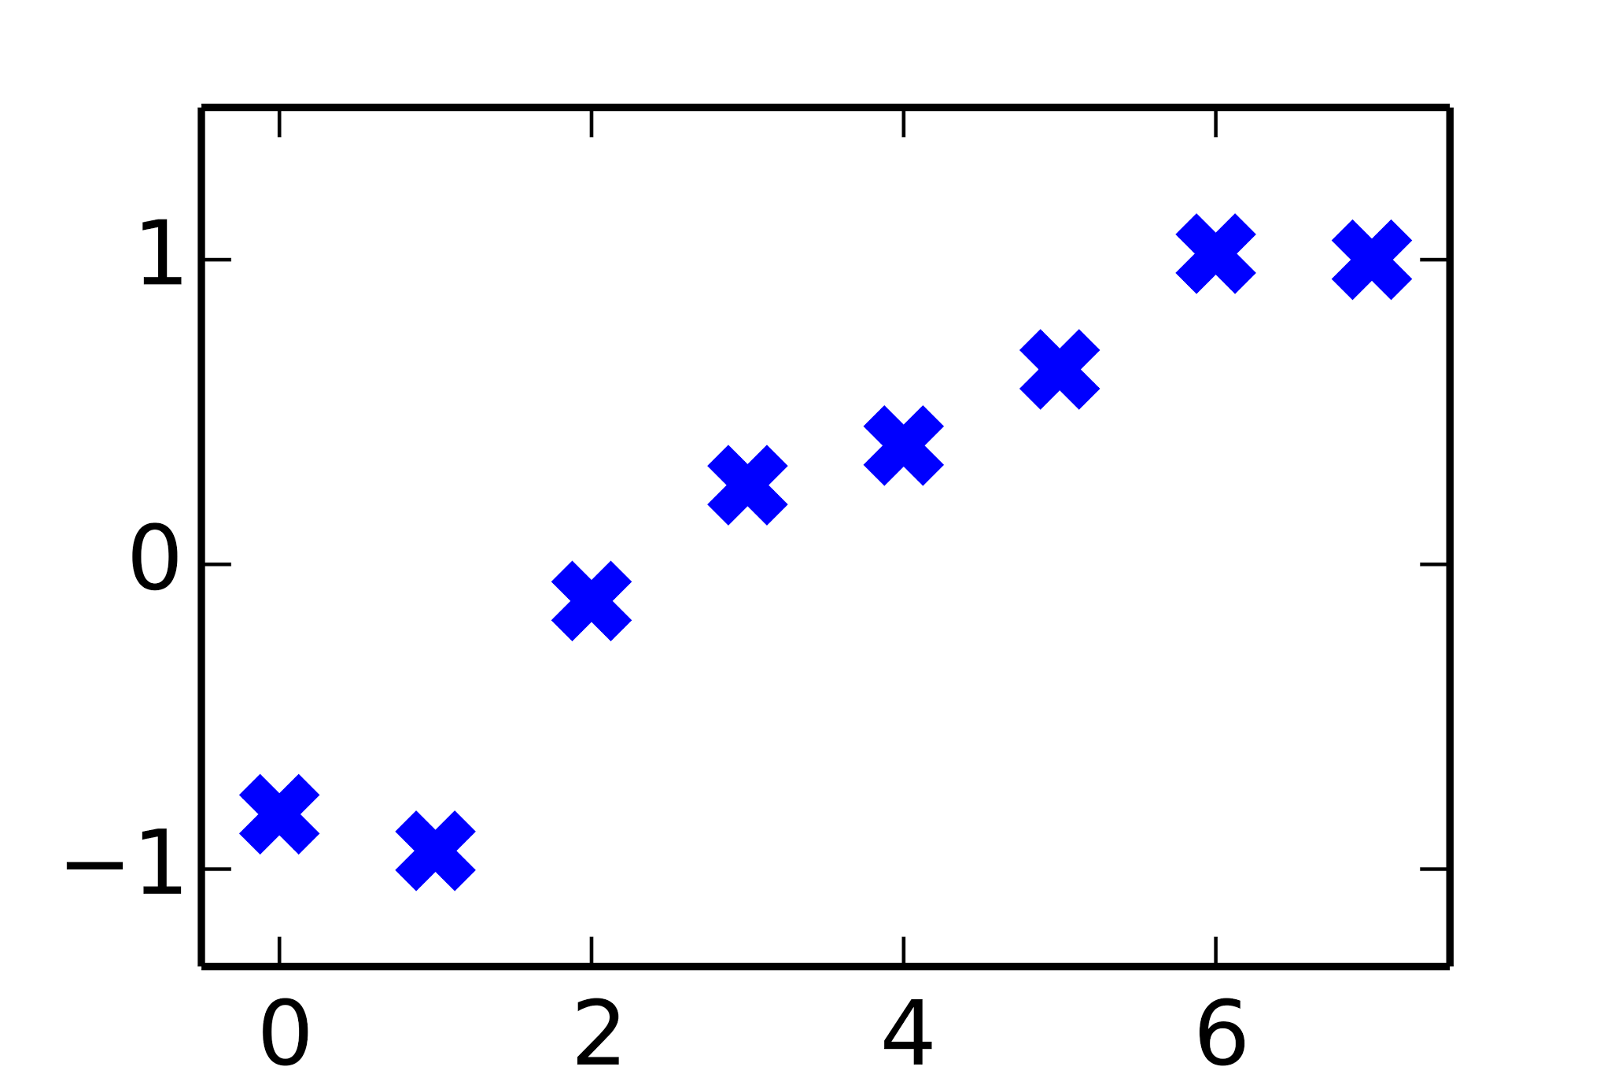
y = m∙x + b
slope
y-intercept

Slide 5
0 import tensorflow as tf
1
2 xs = [ 0.00, 1.00, 2.00, 3.00, 4.00, 5.00, 6.00, 7.00]
3 ys = [-0.82, -0.94, -0.12, 0.26, 0.39, 0.64, 1.02, 1.00]
4
5 m_initial = -0.5
6 b_initial = 1.0
7
8 m = tf.Variable(m_initial)
9 b = tf.Variable(b_initial)
10
11 error = 0.0
12 for i in range(len(xs)):
13 y_model = m*xs[i]+b
14 error += (ys[i]-y_model)**2
15
16 operation = tf.train.GradientDescentOptimizer(learning_rate=0.001).minimize(error)
17
18 with tf.Session() as session:
19 session.run(tf.initialize_all_variables())
20
21 for iteration in range(10000):
22 session.run(operation)
23
24 print('Slope:', m.eval(), 'Intercept:', b.eval())

Slide 6
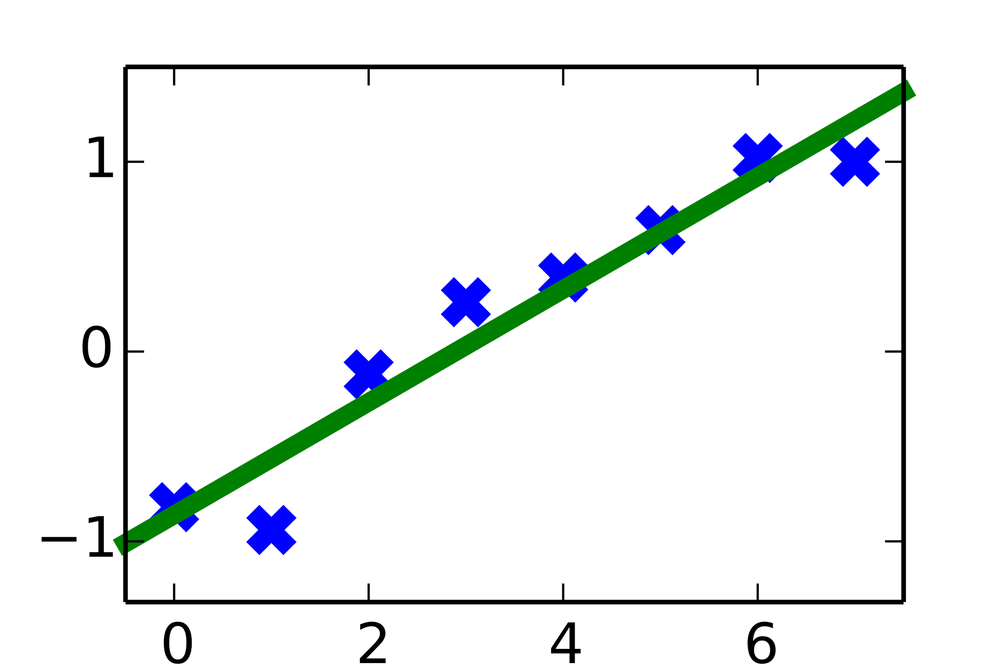
$ python3 serial.py
Slope: 0.297022 Intercept: -0.860827
$ # Runtime was 11.1 seconds

Slide 7
Math Functions
Control Flow
tf.exp tf.pow
tf.tan tf.sign
tf.cond
tf.do_while
Tensor Operations
tf.matmul tf.add
tf.reduce_sum tf.cumprod

Slide 8
But wait, what are Tensors?
[ 0.3, 0.2, 0.4, 0.5, 0.9 ]
[
[ 0.3, 0.2, 0.4, 0.5, 0.9 ],
[ 0.6, 0.0, 0.8, 0.5, 0.4 ],
[ 0.2, 0.8, 0.8, 0.1, 0.3 ]
]

Slide 9
0 import tensorflow as tf
1
2 xs = [ 0.00, 1.00, 2.00, 3.00, 4.00, 5.00, 6.00, 7.00]
3 ys = [-0.82, -0.94, -0.12, 0.26, 0.39, 0.64, 1.02, 1.00]
4
5 m_initial = -0.5
6 b_initial = 1.0
7
8 m = tf.Variable(m_initial)
9 b = tf.Variable(b_initial)
10
11 ys_model = m*xs+b
12 error = tf.reduce_sum((ys-ys_model)**2)
13
14 operation = tf.train.GradientDescentOptimizer(learning_rate=0.001).minimize(error)
15
16 with tf.Session() as session:
17 session.run(tf.initialize_all_variables())
18
19 for iteration in range(10000):
20 session.run(operation)
21
22 print('Slope:', m.eval(), 'Intercept:', b.eval())

Slide 10
$ python3 tensor.py
Slope: 0.297022 Intercept: -0.860827
$ # Runtime was 2.5 seconds

Slide 11
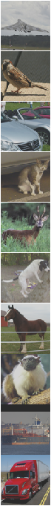
[ 0.3, 0.2, 0.4, …, 0.6 ]
Same Model
Airplane
[ 0.1, 0.2, 0.1, …, 0.2 ]
Same Model
Cat
[ 0.9, 0.7, 0.7, …, 0.0 ]
Car
Same Model
[ 0.6, 0.5, 0.5, …, 0.4 ]
Cat
Same Model
[ 0.3, 0.4, 0.3, …, 0.2 ]
Same Model
Deer
[ 0.8, 0.9, 1.0, …, 0.1 ]
Same Model
Dog
[ 0.2, 0.2, 0.7, …, 0.3 ]
Deer
Same Model
[ 0.6, 0.4, 0.1, …, 0.4 ]
Same Model
Monkey
[ 0.9, 0.3, 0.1, …, 0.2 ]
Same Model
Ship
[ 0.3, 0.2, 0.3, …, 0.1 ]
Same Model
Truck

Slide 12
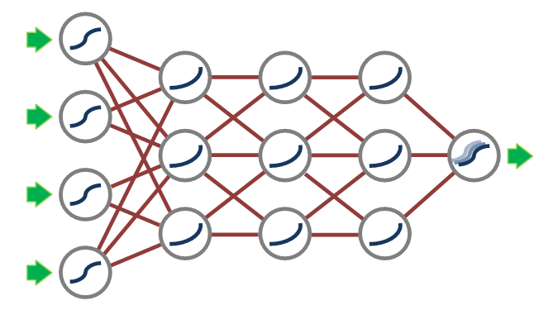
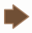
Non-
linearity
Matrix
Mul.
Non-
linearity
Matrix
Mul.
Non-
linearity

Slide 13
Advice
Learn about gradient optimization
For most models, gradient optimization is inefficient
Explore different built-in optimizers

